Slide 1
Project 3 – Logical Programming
Olivia Bravo

Slide 2
Logical Programming
Logical programming is a type of programming that is largely based on formal logic
Logical programming can contain loops, Boolean operators, arrays, if-else and other statements
This Word Counter program in C++ will use arrays, pointers, if statements and a while loop

Slide 3
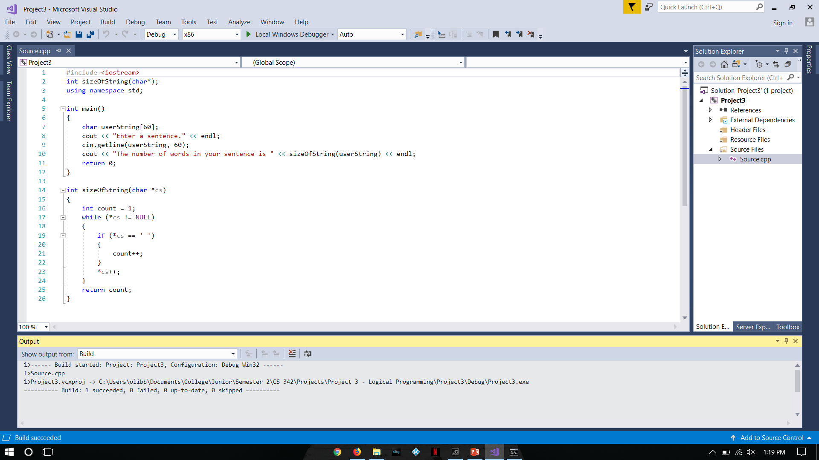
Word Counter Program
This program contains two functions: the main function and the sizeOfString function
The sizeOfString function is defined alongside the headers
The declared char variable named userString[60] has an array size of 60, meaning the maximum amount of characters in the variable is 60
The main program receives the sentence from the user and gets the length of the sentence through the sizeOfString function

Slide 4
sizeOfString Function
The sizeOfString function takes the temporary variable named cs. The while loop uses the cs variable, which contains our sentence (userString[60])
The * symbol in C++ represents a pointer, which points to the address in data the memory
The while loop checks to see if the address contains a NULL. If it is a NULL, the while loop will finish
Inside the while loop, the if statement checks to see if the address contains a space character. If it does, the count variable increments
After the if statement, the address of the variable cs increments, which means it checks the next address to see if there is a character or NULL
The count variable is used to count how many words are in the sentence
What the array looks like in memory:
| T | h | e | | q | u | i | c | k | | b | r | o | w | n | | f | o | x | | j | u | m | p | s| | o | v | e | r | | a | | l | a | z | y | | d | o | g |

Slide 5
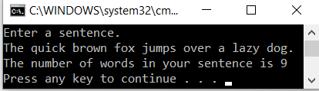
Final Output
The sizeOfString function is called within the output
Once the while loops is finished, the temporary variable count is returned to the main program
Output:

